Slide 1
HUMAN FACE
DETECTION SYSTEM

Slide 2
Minor Project
Submitted By:
Manjeema Bhattacharjee
Nabarun Samaddar
Arindam Sarkar
Under The Guidance Of:
Mr Dhiman Karmakar
Mrs Puja Mukherjee

Slide 3
Contents
What is face detection
What is human face detection
Our proposed method
Algorithms used
Viola Jones algorithm
T pattern
WBW pattern
Applications
Advantages, Disadvantages and Future Scopes
Summary
References
Acknowledgement

Slide 4
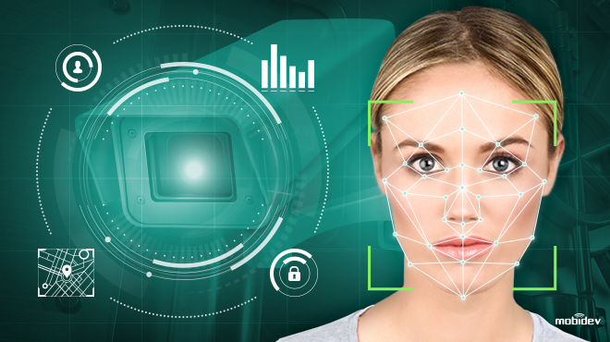
What Is Face Detection?
Face detection is a computer technology used in a variety of applications that identifies human faces in digital images.
Face detection also refers to the psychological process by which humans locate and attend to faces in a visual scene.

Slide 5
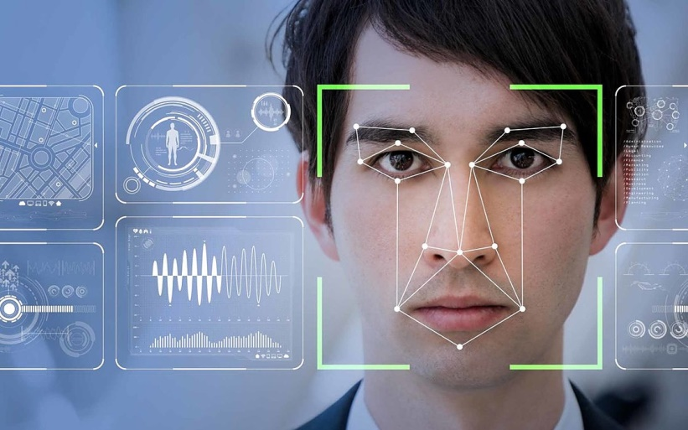
What Is Human Face Detection?
Human face detection means that a system is able to identify that there is a human face present in an image or video.

Slide 6
Our Proposed Method
Considering an coloured image and converting it into grey scale image.
Searching for the facial features in the grey scale image.
Applying a “T” structure to enclose the 4 distinct features of a face i.e. left eye, right eye, nose and lips which are already been detected in the grey scale image.
Searching for the “WBW” pattern in the eyes so as to confirm that the face detected is a human face.

Slide 7
Algorithms Used
Viola Jones Algorithm
T Pattern
WBW Pattern

Slide 8
Viola Jones Algorithm
Developed in 2001 by Paul Viola and Michael Jones. Viola-Jones algorithm is an object-recognition framework that allows the detection of image features in real-time.
There are 2 stages in the Viola-Jones Algorithm:
Training
Detection

Slide 9
Viola Jones Algorithm
Steps for training:
Training the classifiers with facial and non-facial images and
Adaboost
Steps for detection:
Detecting the Haar-like features and
Creating the integral image

Slide 10
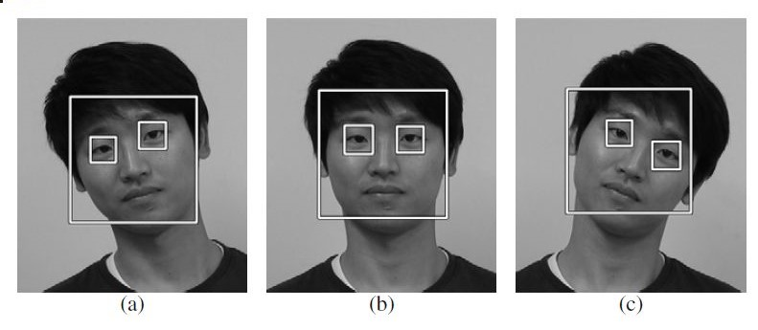
Viola Jones Algorithm
Detection of eyes in frontal face image

Slide 11
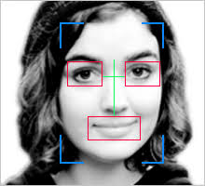
Viola Jones Algorithm
Detection of eyes, nose and lips in frontal face image

Slide 12
T pattern
Consider the 4 features extracted (i.e. left eye, right eye, nose and lips) using Viola-Jones algorithm in the cropped grey scale image.
Take the T pattern of same dimension as the extracted face features image.
Superimpose the T pattern image on the face features image.
Compare the 4 face features with the T pattern and confirm for the human face.

Slide 13
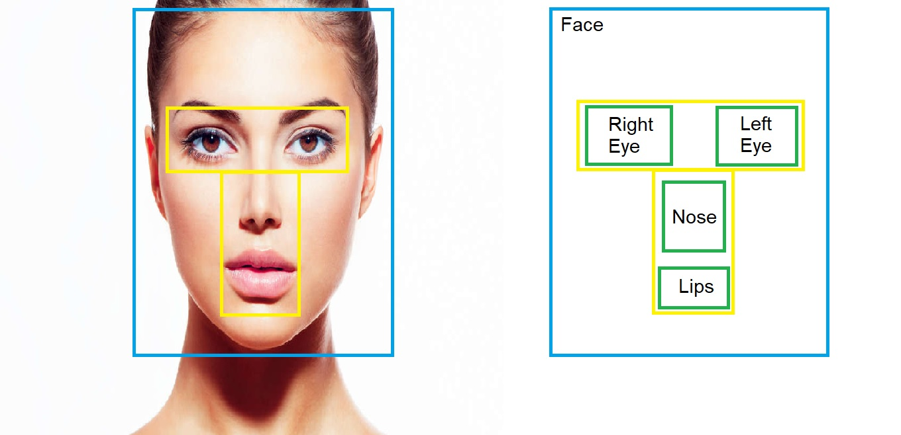
T pattern
T pattern enclosing the 4 facial features

Slide 14
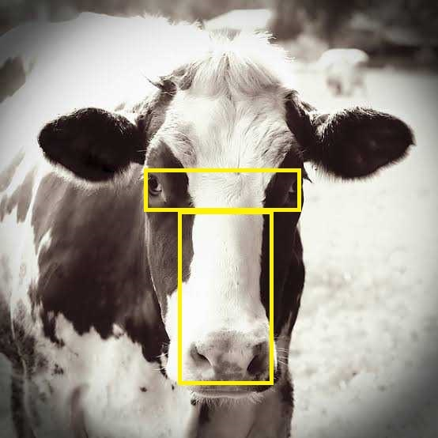
T pattern
T pattern is not valid for the animal having side eyes

Slide 15
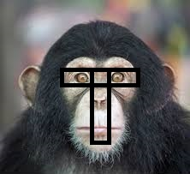
T pattern
T pattern is valid for the ape species

Slide 16
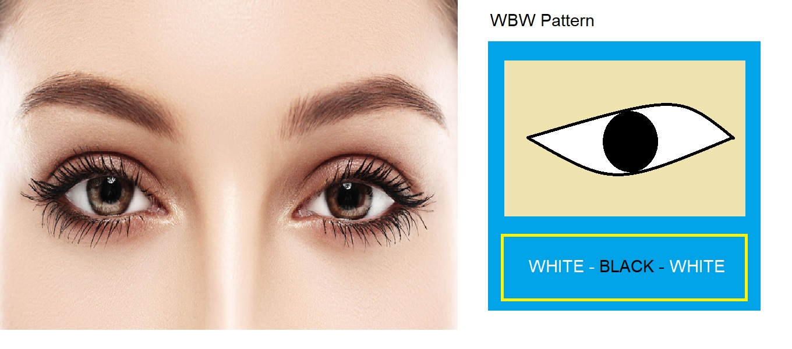
WBW pattern
WBW pattern of the human eyes

Slide 17
WBW pattern
First we will look for WBW pattern in frontal face image(WBW pattern means white part of eyes then black pupil then again white part of eyes )
After getting such pattern we will try to find out another one which should be almost parallel to the previous pattern with respect to area of that previous WBW pattern

Slide 18
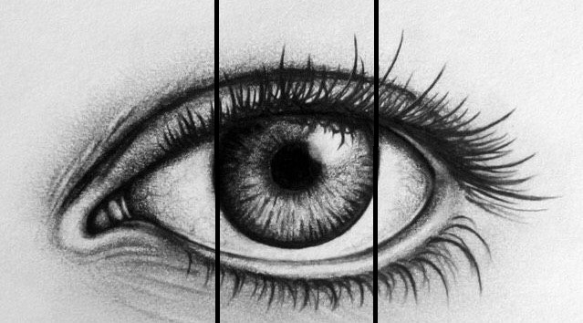
WBW pattern
WBW pattern is valid for the human eyes

Slide 19
WBW pattern
Next we will calculate the altitude from base to nose tip ( base divided by 2 for the starting point and ending point would be the middle of BWB pattern )
After then we will form another ISOSCELES triangle from the middle of the BWB pattern to find out a non linear dark line ( made by space between upper and lower lips )
Now our “X” pattern is complete, where upper parts of X should be greater than lower part
Then we will get our “I” pattern through an altitude from the innermost corners of the eyes ( tip point from base to that non linear dark line of lips )

Slide 20
WBW pattern
Firstly no animal has both eyes in front face (exceptions are there, eg: ape ). But in the case of ape two things might happen:
We would not find WBW pattern because most of them has fully black eyes.
For the ape species which don’t have fully black eyes the have yellow parts surrounding the black pupils.

Slide 21
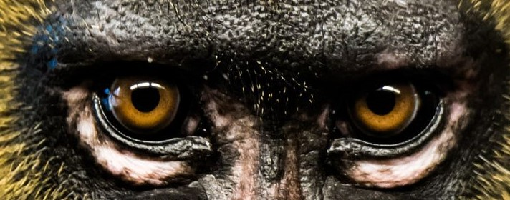
WBW pattern
WBW pattern is not valid for the ape species

Slide 22
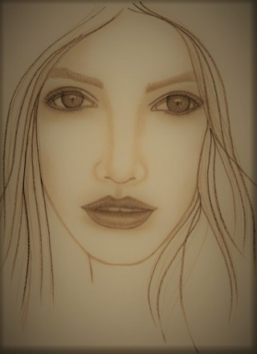
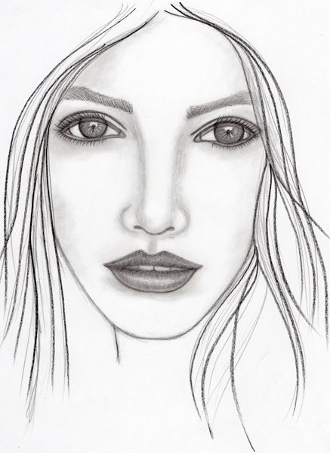
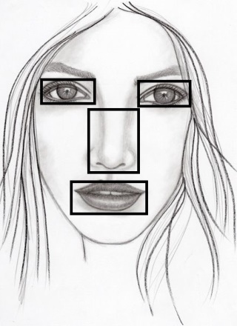
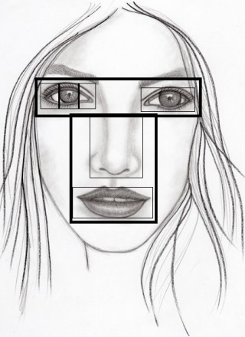
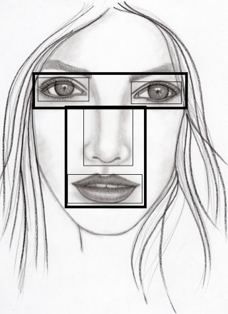
Final Output
Applying Viola Jones Algorithm to detect the 4 facial features
To grey scale
Applying WBW pattern on the eye to confirm for human face
Applying T pattern to enclose the 4 facial features detected

Slide 23
Applications
Facial motion capture
Facial recognition
Photography
Marketing
Emotional Inference
Lip Reading

Slide 24
Advantages
Independent of Skin Textures
Independent of Light Effects
Independent of Facial Marks
Platform Independent

Slide 25
Disadvantages
Image conversion to Grey Scale is mandatory
Frontal face image is must
All four face features are required

Slide 26
Future Scopes
Time complexity reduction
Overcome mandatory requirement of all 4 face features

Slide 27
Summary
The computer based facial recognition industry has made many useful advancement in the past decade; however, the need for higher accuracy remains. Through the determination and commitment of industry, government evolutions and organised standard bodies, growth and progress will continue, raising the bar for face detection and recognition technology.
Still working on algorithms to detect face from different angles.

Slide 28
References
Reliable Face Detection Method by Harry Wechsler
Advances in Facial Image Analysis by Michal Kawulok
Website: www.wikipedia.com
Website: www.researchgate.net
Website: www.sciencedirect.com
Research Paper by G. Bala Kumar, year of publishing: 2003

Slide 29
Acknowledgement
The success and final outcome of this project required a lot of guidance and assistance from many people and we are extremely privileged to have got this all along for the completion of our project. All that we could have done is only due to such supervision and assistance and we would not forget to thank them.
We owe our deep gratitude to our project guide Mrs. Puja Mukherjee, who took keen interest on our project work and guided us all along, till the completion of our project work by providing all the necessary information for developing a good system.
We heartily thank our Head of The Department Mr. Dhiman Karmakar, for his guidance and support during this project work.

Slide 30
Thank you Sir/ Madam
For Providing Your Valuable Time And Energy

